Slide 1
G2M Case Study
By Mohamed Akrem Ben Jemia

Slide 2
Mission
Giving recommundation to XyZ company . This company is planning for an investment in Cab industry and as per their Go-to-Market(G2M) strategy they want to understand the market before taking final decision.
Objectif : making statistic stady for the tow company yellow cap and pink cap

Slide 3
Data preprocessing
Data Provided includes 4 csv files
Cab Data - Transaction Id, Date of Travel, Distance, Price Charged, and Cost to Company
City Data - Data on each city the cab company operates in
Customer Data - Includes Customer ID, Age, and Income
Transaction Data - Documents each transaction price, time, and which customer
Merging all files to one single data set

Slide 4
Hypothèses
Hypothesis 1: Does the season affect amount of Cab users?
Hypothesis 2: Does the city affect profit margins for Cab company?
Hypothesis 3: Do customer loyalty affect each Cab company?
Hypothesis 4: Does income of cab users affect the profit gained per trip?
Hypothesis 5: How does distance travelled for a ride impact the profit per ride?

Slide 5

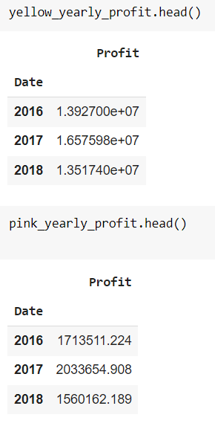
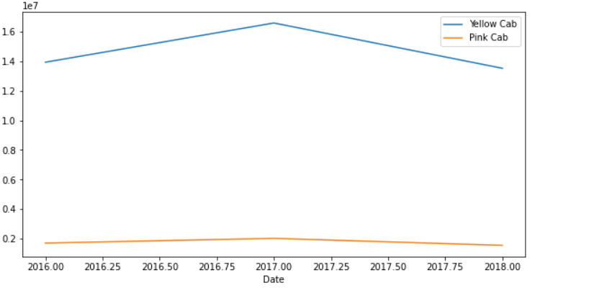
Company profits

Slide 6
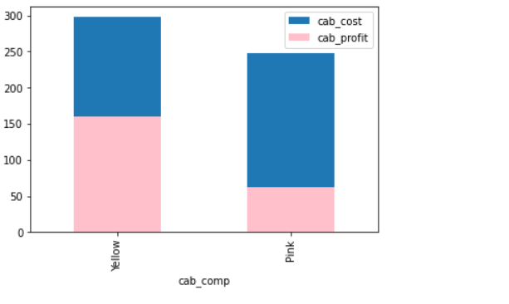
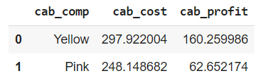
Profits vs Cost of Trip
This graph shows the Yellow Cab company operates each individual ride at a significantly lower cost for each trip which increases their average profit of each trip by nearly 100.

Slide 7
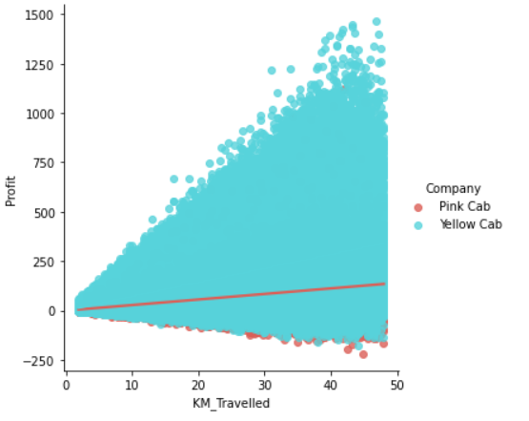
Profits vs Distance Travelled
More the distance is important more the profet of yellow cap is more signigficants

Slide 8
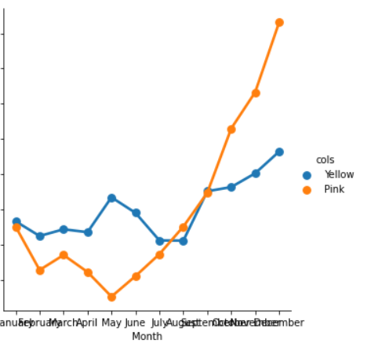
Profet per monthes of year
Pink company over uses lasts months however yellow is have a constant avrege during all the year

Slide 9
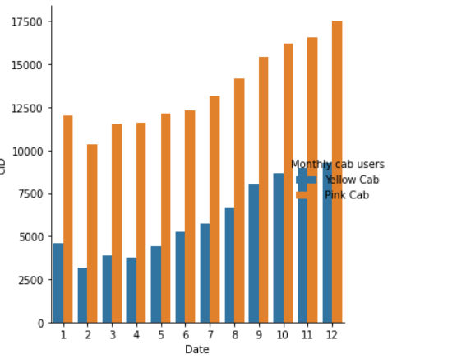
Users
Yellow Cab consistently has more monthly users.

Slide 10
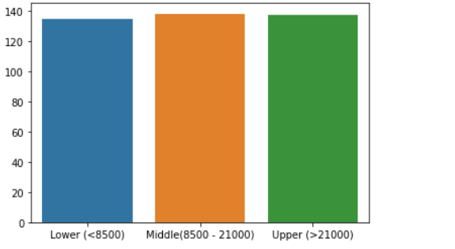
Profits for each Income Class User
the middle class providing the most by a slim margin.

Slide 11
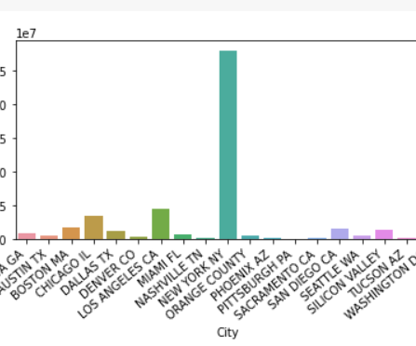
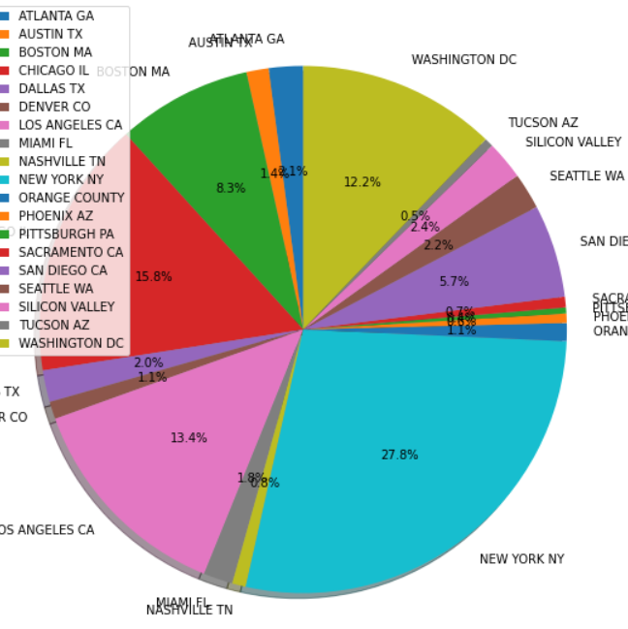
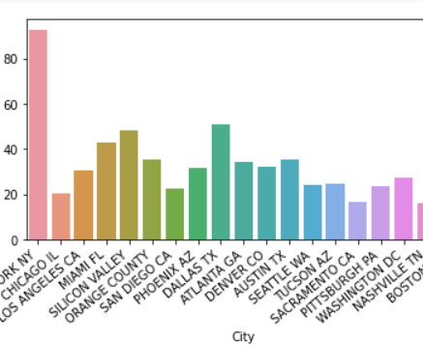
Profit and citys
New York city has the highest profit per user

Slide 12
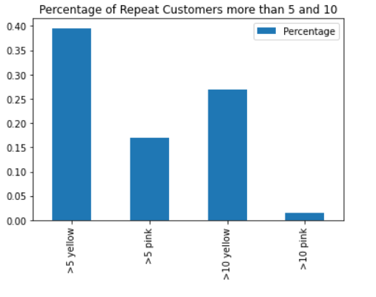
Loyalty
This chart shows the percentage of customers in each company that have used the same company more than 5 and 10 times.

Slide 13
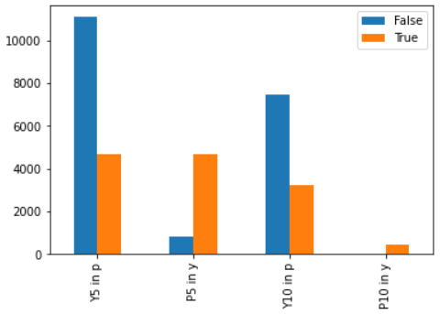
Do the loyal customers (customers with more than 5 and 10 trips with the same company) use the opposing company?
The False indicated that a loyal customer did not use the opposing company while True means that they did.
From this we can see Yellow customers generally do not use Pink while Loyal Pink customers still use Yellow Cab frequently

Slide 14
Answer to the hypothesis
Hypothesis 1: Yes! Colder seasons( from october to january ) have significantly higher cab usage.
Hypothesis 2: the data shows that NYC Cab companies have an average of 80 profit per user while the rest of the country falls between 20 and 50 per user. Yellow Cab company has significantly more users in NYC which increases their profit margins considerably.
Hypothesis 3: the Pink Cab company most frequent users also frequent the Yellow Cab company while
the Yellow Cab Company has shown that its customers overwhelmingly stick with the Yellow Cab company.
Hypothesis 4: No. The data shows us that profit per user remains consistent with each income bracket of its users.
Hypothesis 5:the Yellow Cab company showed that it has significantly higher average profit per kilometer travelled than the Pink Cab Company. The Yellow Cab company utilizes distance travelled for profit much better than the Pink Cab Company

Slide 15
Recommandation
Profit margins per user are much higher while simultaneously having a much higher of users
The Yellow Cab Company operates in significantly more Cites
The Yellow Cab company has a higher user loyalty rate with nearly 70% of their frequent users (users with more than 5 trips) using only the Yellow Cab company, while the Pink Cab Company has a loyalty rate of roughly 10%
The most profitable city per user is NYC and the Yellow Cab company services over 85,000 users in NYC vs the Pink Cab company only servicing 16,000 users.

Slide 16
Thank you

